Slide 1
DIGITAL PORTFOLIO
STUDENT NAME: Priya G
REGISTER NO: 2426K0123
NMID:B3BB2FF44196212A50A4C819201FA6BA
DEPARTMENT: Computer Technology
COLLEGE: Bharathidasan College of Arts and science UNIVERSITY: Bharathiar University

Slide 2
INTERACTIVE DIGITAL PORTFOLIO USING FRONT END WED DEVELOPMENT

Slide 3
AGENDA
Problem Statement
Project Overview
End Users
Tools And Technologies
Portfolio Design And Layout
Features And Functionality
Results And Screenshots
Conclusion

Slide 4
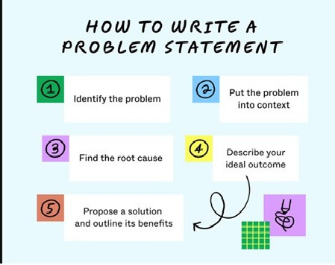
PROBLEM STATEMENT
A problem statement explains the challenges you face with your work, which can affect your operations, launching new products, or improving existing ones. It shows the gap between the current state and the desired state of a process, product, or service.

Slide 5

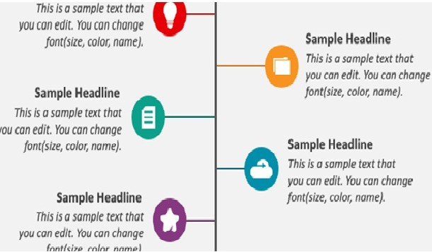

PROJECT OVERVIEW
A project overview is a outline of the project that describes important details about the project. The overview includes the basic information like project name, project manager and sponsers for the project.
It also includes the detailed information that summarizes the project’s value, problem it solves and the goals the team planned to achieve.

Slide 6
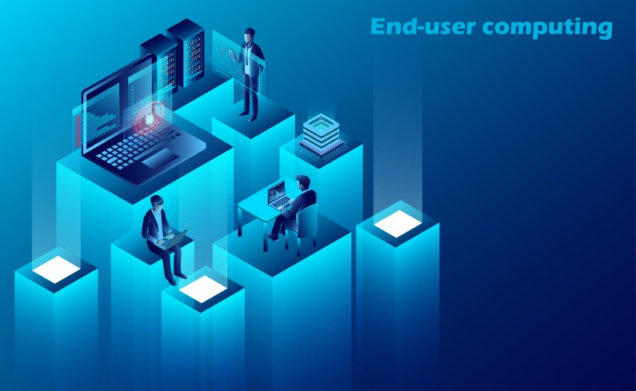
END USERS
The term "end user" refers to the consumer of a good or service, often one who has some innate know-how that is unique to consumers.
In a literal sense, the term is used to distinguish the person who purchases and uses the good or service from individuals who are involved in the stages of its design, development, and production.

Slide 7

Tools And Technologies Used
HTML is a standard markup language to create web pages. In this project HTML is used to provide structure and content of a webpage, which is then styled and laid out using CSS (Cascading Style Sheets) and made interactive using JavaScript.
CSS is a styling language used to control the layout and appearance of web pages written in HTML.
JavaScript is a high-level, dynamic, and interpreted programming language used for client-side scripting on the web. It's primarily used to create interactive web pages, web applications, and mobile applications.

Slide 8
Portfolio Design And Layout
A portfolio design is a webpage design in which an individual’s creative professional work is showcased. These webpage displays the information like about me, skills, projects, resume, contact details, certificates earned in assessments in an organized manner.
About Me → It shows the detailed information about the person one who designs the webpage.
Skills → Skills part shows the skills that the person learned till now in technical manner.
Projects → Projects says about the about work completed by the individual during their college period and in working period.
Resume → It is used to download or to view the curriculum vitae or resume of the person.
Contact Details → It gives the information about the contacts of the creator.

Slide 9
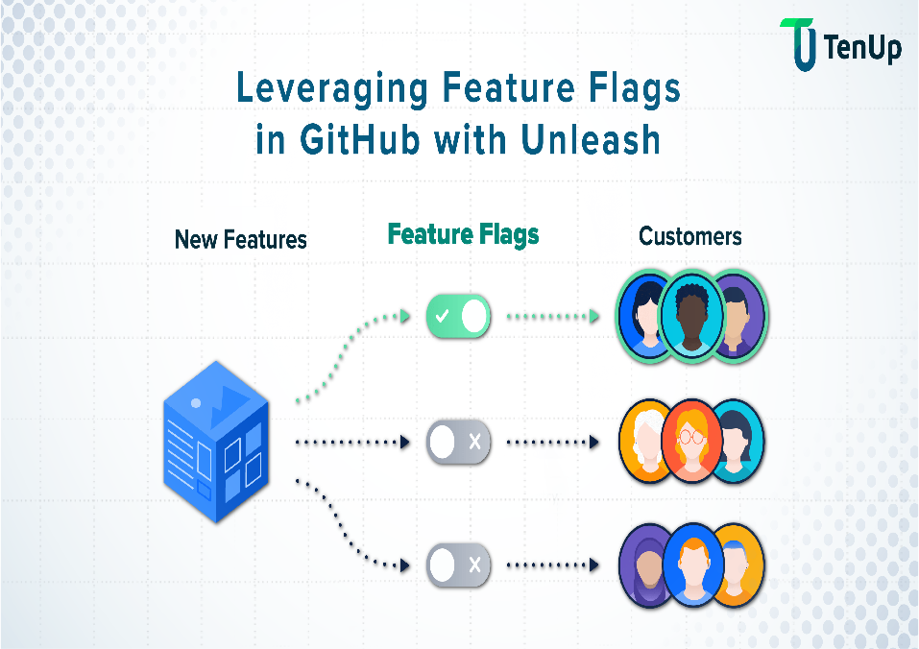
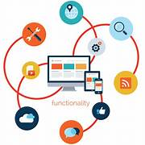
Features and Functionality
Features and functionality are both important aspects of a product or service, but they serve different purposes.
Features refer to specific characteristics or capabilities that a product offers.
Functionality, on the other hand, refers to how well those features work together to provide a seamless user experience. In essence, features are what a product has, while functionality is how well it works.

Slide 10
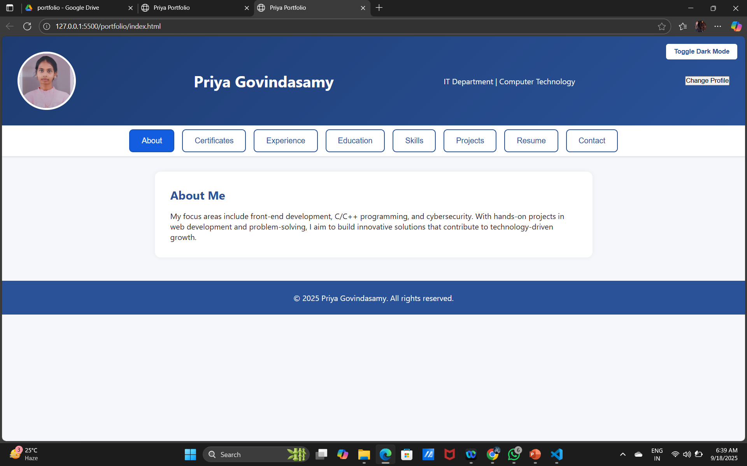
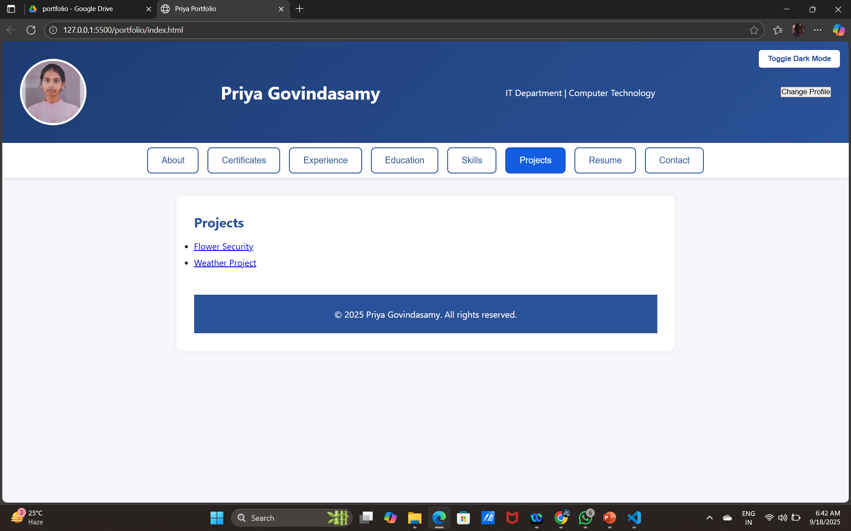
Results And Screenshots
A result (also called upshot) is the outcome or consequence of a sequence of actions or event .A screenshot is an image of the exact thing displayed on the screen of your device.

Slide 11
Conclusion
Here, I have shared my experience while doing the project entitled “Interactive Digital Portfolio Using Front And Wed Development”. I learnt many new things & it wonderful learning experience for me while working on this project. This project increased my research thinking skill and interest in this subject.

